Slide 1
Retail Sales Analysis( Capstone Project)
By- Ankit Kumar
Industry- Retail,
Problem- Profitability
Tools Used- Excel+ Python+ Sql+ Power BI

Slide 2
🔶 Step 1: 🧑‍💼 Business Background (Client Simulation)
Client Name: Trendora Retail Pvt Ltd Industry: Fashion + Lifestyle Retail Company Size: Mid-market, ~250 stores, online & offline presence Regions: North, South, East, West Product Categories: Apparel, Footwear, Electronics, Accessories Customer Base: 3M+ users, with loyalty program
❗ Business Challenge:
*“Our CFO has noticed that despite rising gross sales, our net profit is declining quarter over quarter. We suspect that frequent product returns may be hurting our margins. Can your team investigate:
What’s driving return behavior?
Are certain SKUs, regions, or customer types abusing returns?
How much profit are we losing from this?”*

Slide 3
🔎 Step 2: Business Questions from Client
You, as the BI Analyst, now need to answer:
What is our overall return rate?
Which product categories or SKUs have the highest return rates?
Which customer segments (loyalty, region) return the most?
How does return behavior change over time (seasonality)?
Are high-return SKUs also low-profit?
What is the return-related profit loss per region?
Do loyal customers behave differently?
Which 5 SKUs are the worst offenders?

Slide 4
🔮 Step 3: Hypothesis Thinking
🔮 Step 3: Hypothesis Thinking (Consultant Style)
Hypothesis | Reason
“Accessories have the highest return rate” | Low price, impulse buys
“North region has higher returns” | Historical complaints about sizing issues
“Loyal customers return less” | Better product-fit + trust
“Returns spike during sales months” | Impulse + wrong sizing

Slide 5
📦 Step 4: Provided Data (Simulated, Cleaned)
Table | Key Columns
customers.csv | customer_id, region, loyalty_flag
orders.csv | order_id, customer_id, order_date
order_items.csv | order_id, sku, quantity, price, is_returned
products.csv | sku, category, cost_price
Data Insights:
~50,000 orders across 12 months
4 main regions, 5 categories, 1.5K+ SKUs
3% missing values, cleaned in Python

Slide 6
📊 Slide 4: Key KPIs + SQL Logic
KPI | Formula | Value
Return Rate | Returned_Qty / Total_Qty | 7.8%
Return Loss ₹ | (Returned_Qty × Profit_per_unit) | ₹8.2L
Top Return Category | Accessories | 14.2%
Worst Region | North | 9.6% return rate

Slide 7
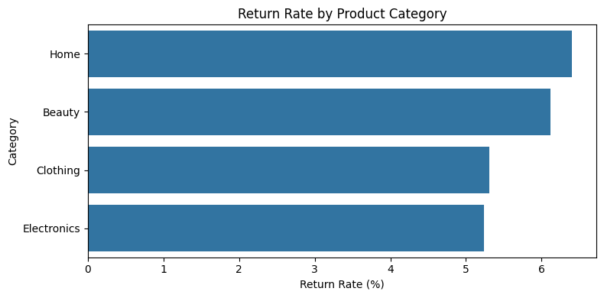
📈 Slide 5: Python EDA Highlights
Trends Observed:
Returns spike during Nov-Dec (Sale months)
Loyal customers return 40% less than new ones
Accessories and Footwear = highest return categories
High-return SKUs have lower average profit margins

Slide 8
🖥️ Slide 6: Power BI Dashboard Highlights
🪟 Dashboard Sections:
KPIs: Return Rate, Gross Profit, Return Loss
Visuals: Return Rate by Region, Category, Month
Filters: Region, SKU, Category, Loyalty

Slide 9
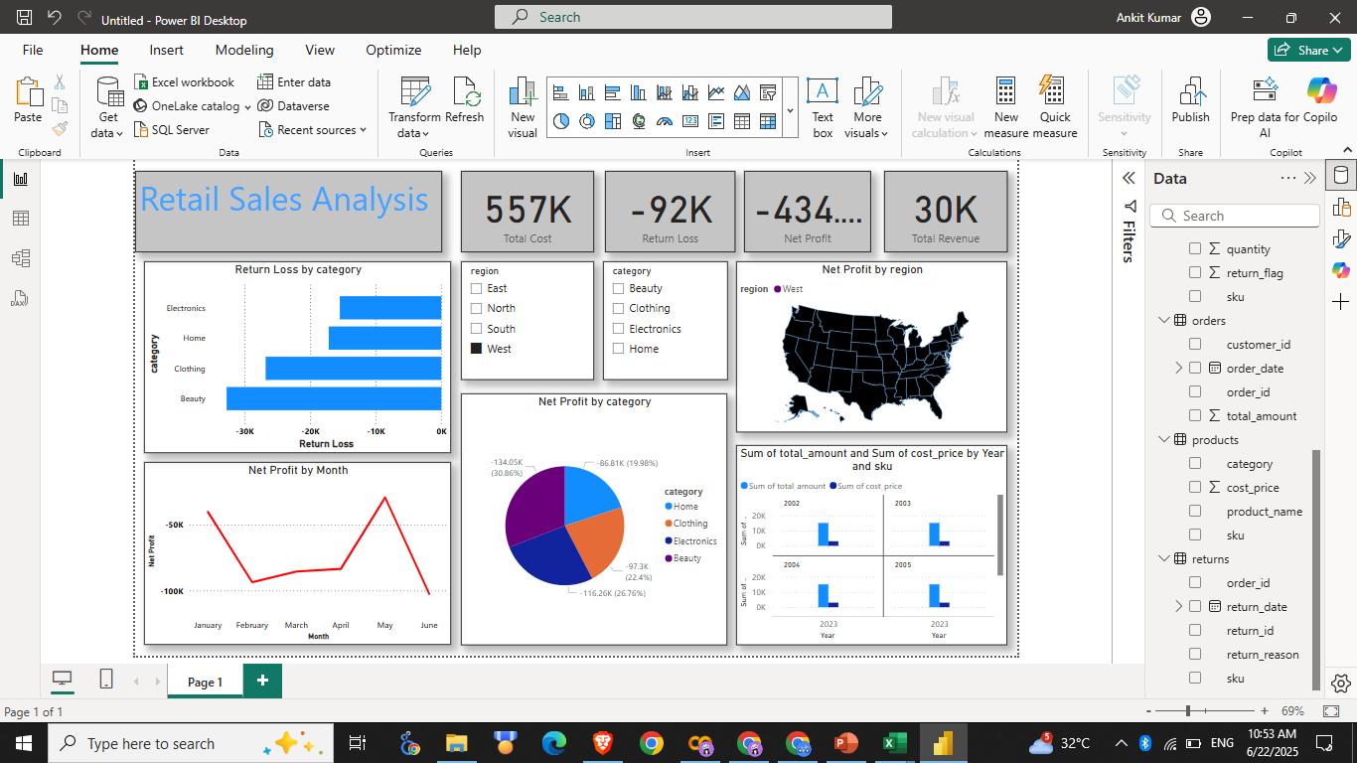
Dashboard

Slide 10
✅ Slide 7: Recommendations & Actions
🎯 As a BI Consultant, recommendation:
Flag SKUs with return rate >25% for review
Separate sizing guides for high-return categories
Target high-returns regions with better CX interventions
Reward loyal customers with return benefits (they return less)
Avoid over-discounting in Nov-Dec

Slide 11
💬 Slide 8: Executive Summary (Stakeholder View)
Despite 12% growth in sales, ₹8.2L lost to returns. Most return losses come from Accessories + North Region. Targeting top 5 high-return SKUs and CX improvements in the North can recover ~₹2.5L quarterly. Actionable insights deployed to Retail Ops and Product Teams.

Slide 12
Thank You

